Slide 1
CRISP – DM Process for ‘Credit Approval’
SWEN 5931 – Research Topic in Software Engineering
Rushikesh Kishor Mangrulkar
1315331

Slide 2
Content
Business Understanding
Data Understanding
Data Preparation
Modelling
Model Training and Testing
Evaluation

Slide 3
Business Understanding
Objective: The aim of the analysis is to demonstrate analytical techniques to approve or deny credit card applications
Plan: The plan involves importing dataset from UCI repository
Final model will be classification model which will be able to predict the outcome of credit applications

Slide 4
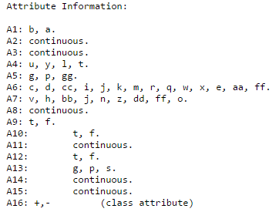
Data Understanding
Attributes names and values changed to meaningless symbols

Slide 5
Data Understanding
The dataset holds some missing values
Some columns holding numbers are binomial
The ‘Approved’ column can be set as target attribute, and is converted to binomial while importing
The column holds ‘+’ for approved and ‘-’ for not approved
Four factors in the data can affect the approval decision, while others may not have any impact.
Prior Default, Years Employed, Credit Score and Income Level

Slide 6
Data Preparation
Certain columns with numbers are converted from Binomial to Real or Integer while importing data into Rapid Miner
The data holds 690 rows, which being less in number we plan to import all of it
The attributes are provided meaningful headers using ‘Rename’ operator [1]
Set Role for the target attribute ‘Approved’
‘Replace Missing Values’ be used to replace missing values, preferably the are replaced with average values

Slide 7
Modeling
‘Discretize by Binning’ operator is used for pre-processing purposes.
It is used for converting type of all numeric attributes to nominal
After passing, all those attributes will have three possible values i.e range1, range 2 and range 3 when the number of bin parameter is set to 3

Slide 8
Model Training and Testing
The Cross validation operator is used in this case
Parameters are used with defaults (number of validations parameter is 10)
The Cross validation provides training data set composed of 9 out of 10 subsets through training port of Training sub processes
The training data set used as input to ‘Naïve Bayes’ operator

Slide 9
Model Training and Testing
The ‘Naïve Bayes’ classification model that was provided at the model port of training sub process is further provided to the model part of Testing sub process
The ‘Apply Model’ operator applies the Naïve Bayes classification model on testing dataset, the resultant dataset is delivered output by Apply Model operator and further input to Performance (Binomial Classification) operator

Slide 10
Model Training and Testing
The class label attribute has two possible values hence it was set to binomial and that is why the model will be predicted by binomial classification algorithms

Slide 11
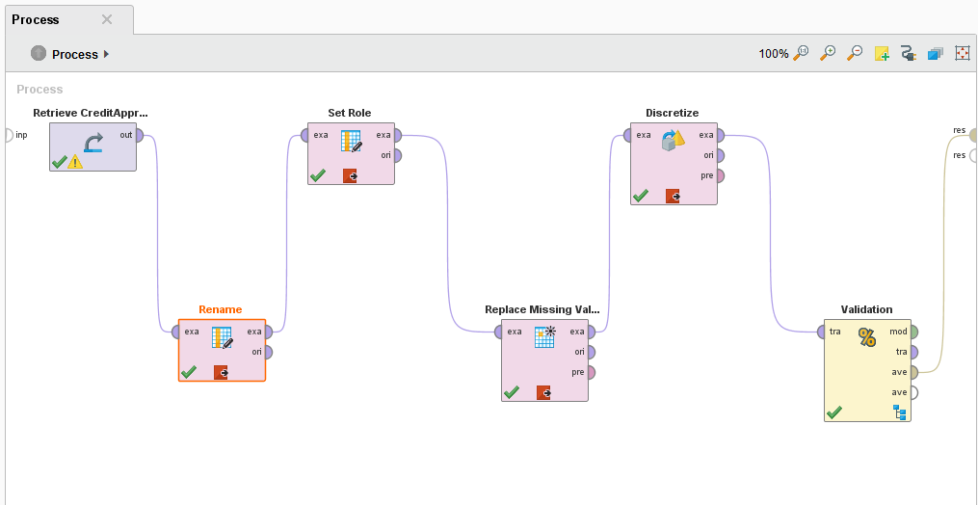
Evaluation
The accuracy of the model turns out to be 84.78%

Slide 12
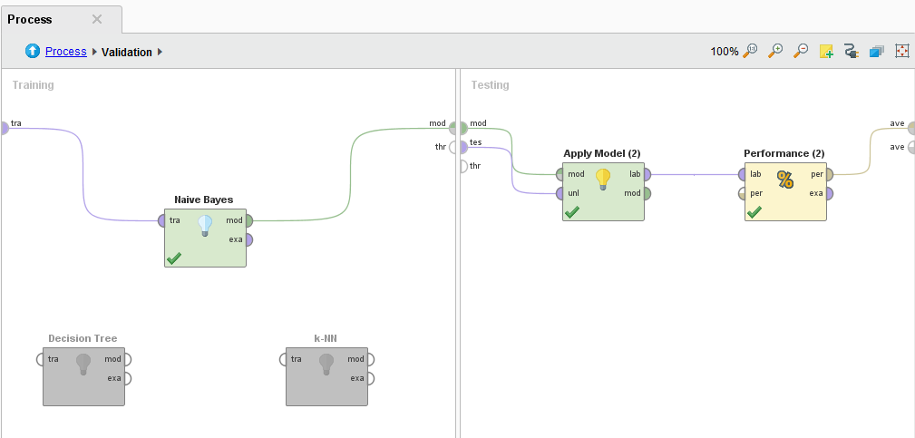
Evaluation

Slide 13
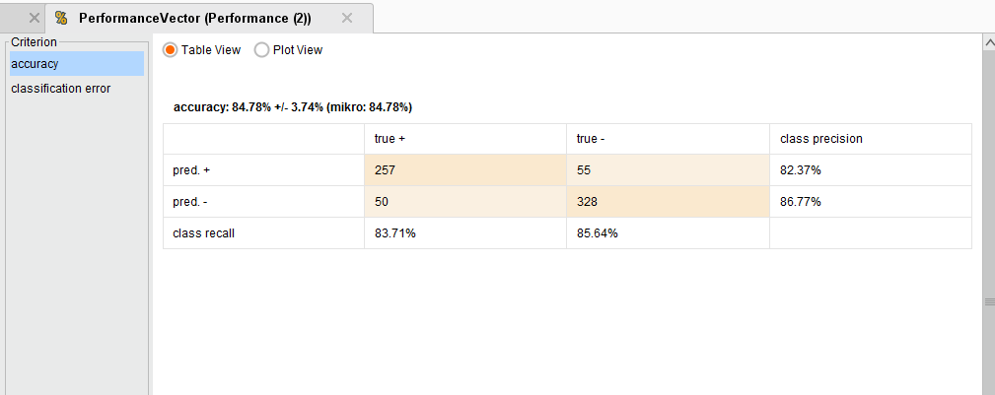
Evaluation

Slide 14
References
[1] Analysis of Credit Approval Data
Author: Ryan Kuhn
http://rstudio-pubs-static.s3.amazonaws.com/73039_9946de135c0a49daa7a0a9eda4a67a72.html
[2] Dataset at UCI
https://archive.ics.uci.edu/ml/datasets/Credit+Approval

